Slide 1
Data Preprocessing Using Pandas in Python
DSA0405 - Fundamentals of data science - Technical presentation - Mythrea shree (192424089)

Slide 2
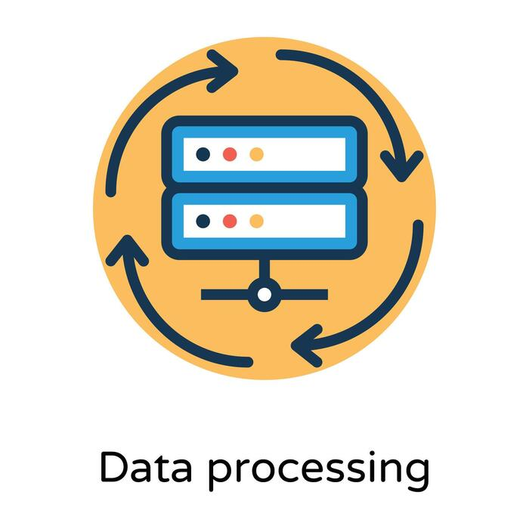
INTRODUCTION
What is Data Preprocessing?
Data preprocessing is the process of cleaning, organizing, and transforming raw data into a format suitable for analysis and machine learning.
Why is it Important?
Improves data quality
Removes inconsistencies
Handles missing values
Reduces errors
Improves model accuracy
Makes data easier to analyze
Example:
A student database may contain missing marks, duplicate records, or incorrect names. Preprocessing fixes these issues before analysis.

Slide 3
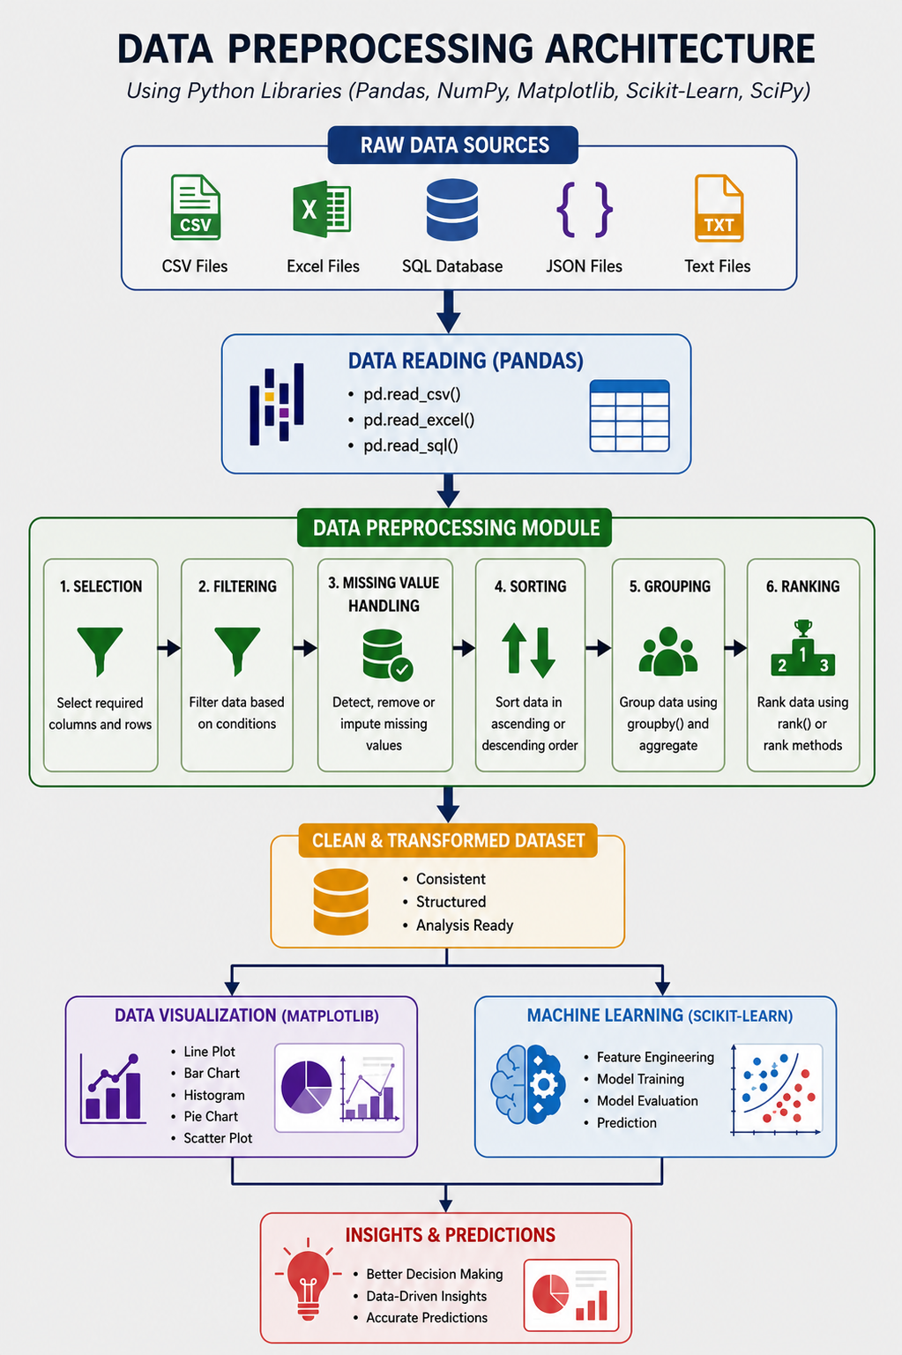
Data Preprocessing Workflow
This workflow shows how raw data is converted into clean and useful data. The dataset is read using Pandas, processed through steps like filtering, sorting, grouping, and handling missing values, and then used for visualization or machine learning to generate meaningful insights.

Slide 4

Python Libraries Used
NumPy – Provides fast numerical computations using multidimensional arrays and mathematical operations.
Pandas – Used for data manipulation, including reading, cleaning, filtering, sorting, and grouping datasets.
Matplotlib – Creates visual representations of data such as line graphs, bar charts, pie charts, histograms, and scatter plots.
SciPy – Offers advanced scientific computing tools for optimization, integration, statistics, and linear algebra.
Scikit-Learn – Provides machine learning algorithms for classification, regression, clustering, and model evaluation.

Slide 5
Reading Data Using Pandas
Import the Pandas library using import pandas as pd.
Load datasets from CSV, Excel, or other file formats using functions like pd.read_csv().
Display the first few records using head() to quickly inspect the dataset.
View dataset information such as columns, data types, and missing values using info().
Generate statistical summaries like mean, count, and standard deviation using describe().
This slide explains how Pandas is used to import and examine datasets. It introduces the basic functions for loading data, viewing records, checking data types, and generating summary statistics before preprocessing begins.

Slide 6
Selecting, Filtering & Handling Missing Data
Select Data – Retrieve specific rows or columns from the dataset.
Filter Data – Display records that satisfy a given condition.
Identify Missing Values – Detect incomplete or null data using isnull().
Remove Missing Values – Delete incomplete records using dropna().
Fill Missing Values – Replace missing entries using fillna() with suitable values.
Benefit – Improves data quality, consistency, and accuracy before analysis or machine learning.
This slide explains how Pandas is used to select relevant data, filter records, and handle missing values. These preprocessing techniques help create a clean and reliable dataset for further analysis.

Slide 7
Data Organization & Visualization
Sorting – Arranges data in ascending or descending order for easier analysis.
Grouping – Organizes similar records into categories using groupby().
Ranking – Assigns ranks to values based on performance or priority.
Visualization – Converts processed data into graphical formats for better understanding.
Common Charts – Includes line charts, bar charts, pie charts, histograms, and scatter plots.
Outcome – Helps identify patterns, trends, and insights for informed decision-making.

Slide 8

conclusion
Data preprocessing is a crucial step in data science that transforms raw, unstructured data into a clean and usable format.
Pandas provides powerful tools for reading, selecting, filtering, sorting, grouping, ranking, and handling missing data efficiently.
Matplotlib enables the creation of meaningful charts and graphs, making complex datasets easier to understand and interpret.
Clean and well-organized data improves the accuracy, reliability, and performance of data analysis and machine learning models.
By combining preprocessing and visualization, organizations can discover valuable insights, make informed decisions, and build more effective data-driven solutions.

Slide 9
Thank you

